Slide 1
Parenthesis normal form
Adding parenthesis to explicitly show the order of evaluation

Slide 2
overview
Expressions are constructed by composing (primitive) values and operations. There are rules specifying which compositions are syntactically legal. It is assumed that you know the rules for how to construct mathematical expressions.
Here we take a look at how to construct integer and Boolean expressions in the functional programming language SML.

Slide 3
Equality types
In SML, an equality type is a type for which the equality operation is defined. Note that the type real is not an equality type. However, the types int and bool are equality types.
int = { min, …, ~2, ~1, 0, 1, 2, … max }
bool = { false, true }

Slide 4
Logical operators
orelse | : | bool ∗ bool → bool
andalso | : | bool ∗ bool → bool
not | : | bool → bool
Remark:
andalso and orelse are simply a short-hand (i.e., a derived form) for if-then-else expressions. Furthermore, the not operator is a function (i.e., a left-associative operator with highest precedence).

Slide 5
Derived forms
e₁ orelse e₂ = if e₁ then true else e₂
e₁ andalso e₂ = if e₁ then e₂ else false

Slide 6
Relational operators
< | : | int ∗ int → bool
<= | : | int ∗ int → bool
> | : | int ∗ int → bool
>= | : | int ∗ int → bool

Slide 7
Equality operators
We will use the symbol ″τ to denote types for which equality operations are defined.
Equality operations are defined for integers and Booleans and a variety of other types (discussed later in the semester).
Equality operations are not defined for reals and a variety of other types (also discussed later in the semester).
= | : | ″τ ∗ ″τ → bool
<> | : | ″τ ∗ ″τ → bool

Slide 8
Arithmetic operators
+ | : | int ∗ int → int
− | : | int ∗ int → int
∗ | : | int ∗ int → int
div | : | int ∗ int → int
mod | : | int ∗ int → int

Slide 9
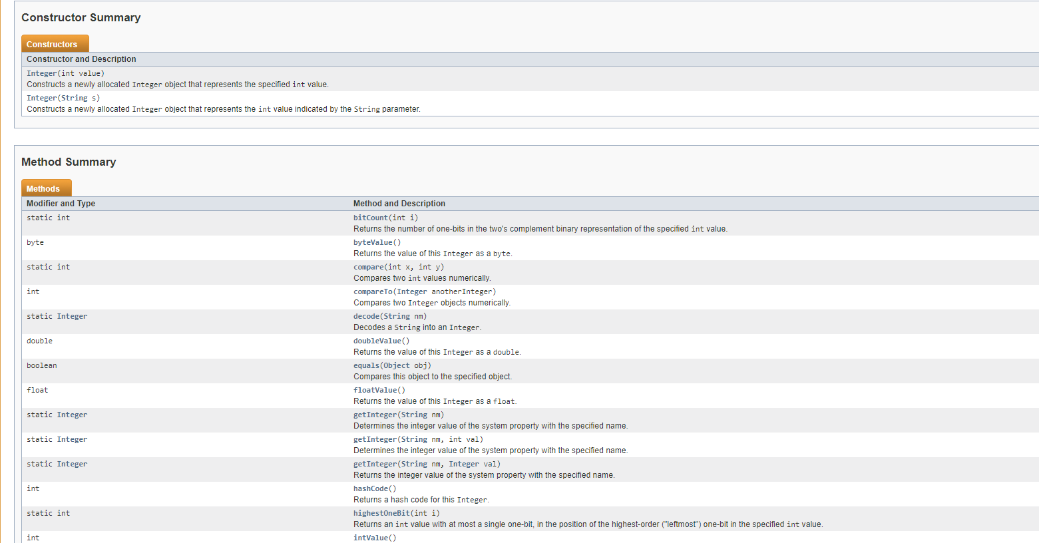
Aside: JavaDoc
https://docs.oracle.com/javase/7/docs/api/java/lang/Integer.html

Slide 10
Precedence and associativity
The precedence table shown below provides the basis for inserting/omitting parenthesis from basic expressions.
operator | precedence | associativity
not | highest | left
∗, div, mod | 7 | left
+, − | 6 | left
=, <>, <, >, <=, >= | 4 | left
andalso | -1 | left
orelse | -2 | left

Slide 11
terms
The structure of rules

Slide 12
The structure of rules
A fundamental question when writing rules is to define the entities to which rules should be applied. There are two natural choices for representing expressions.
An expression is a term - this representation assumes the parsing problem is solved and that you understand the structure of terms.
An expression is a string - this representation assumes the parsing problem is not solved and that you do not understand the structure of terms.

Slide 13
The parsing problem
Conceptually speaking, the parsing problem is what lets us correctly decompose an expression into its parts. In other words, the parsing problem lets us incrementally unravel the compositional steps that were used to create the expression.
Unraveling an expression that is represented as a term (which can be displayed as a two-dimensional object) is easy and parenthesis are not needed.
In contrast, when viewing an expression as a string (a one-dimensional object) we need the help of parenthesis to help us with the incremental unraveling process.
For this reason, our first task is to define how to construct expressions that are appropriately parenthesized.

Slide 14
pnf
Parenthesized Normal Form

Slide 15
Parenthesized normal form
We want to have rules for constructing fully parenthesized expressions (but not overly parenthesized expressions) - it is only notational conventions together with precedence and associativity rules that let us omit parenthesis. We will use the phrase parenthesized normal form to denote expressions that are properly parenthesized, and we will use the symbol E to denote this set of expressions.
v ∈ Int
v ∈ Bool
(E-Int)
(E-Bool)
v ∈ E
v ∈ E

Slide 16
Arithmetic operations
e₁ ∈ E
e₂ ∈ E
e₁ ∈ E
e₂ ∈ E
(E-Plus)
(E-Minus)
(e₁ + e₂) ∈ E
(e₁ − e₂) ∈ E
e₁ ∈ E
e₂ ∈ E
(E-Mult)
(e₁ ∗ e₂) ∈ E
e₁ ∈ E
e₂ ∈ E
e₁ ∈ E
e₂ ∈ E
(E-div)
(E-Mod)
(e₁ div e₂) ∈ E
(e₁ mod e₂) ∈ E

Slide 17
Relational and equality operations
e₁ ∈ E
e₂ ∈ E
e₁ ∈ E
e₂ ∈ E
(E-Lt)
(E-Leq)
(e₁ < e₂) ∈ E
(e₁ <= e₂) ∈ E
e₁ ∈ E
e₂ ∈ E
e₁ ∈ E
e₂ ∈ E
(E-Gt)
(E-Geq)
(e₁ > e₂) ∈ E
(e₁ => e₂) ∈ E
e₁ ∈ E
e₂ ∈ E
e₁ ∈ E
e₂ ∈ E
(E-Eq)
(E-Neq)
(e₁ = e₂) ∈ E
(e₁ <> e₂) ∈ E

Slide 18
Logical operations
e ∈ E
(E-Not)
(not e) ∈ E
e₁ ∈ E
e₂ ∈ E
e₁ ∈ E
e₂ ∈ E
(E-Or)
(E-And)
(e₁ orelse e₂) ∈ E
(e₁ andalso e₂) ∈ E
e₁ ∈ E
e₂ ∈ E
e₃ ∈ E
(E-Cond)
(if e₁ then e₂ else e₃) ∈ E

Slide 19
Example 1: Composition
1 ∈ Int
2 ∈ Int
(E-Int)
(E-Int)
1 ∈ E
2 ∈ E
(E-Plus)
(1 + 2) ∈ E

Slide 20
Example 2: Decomposition
1 ∈ Int
2 ∈ Int
(E-Int)
(E-Int)
1 ∈ E
2 ∈ E
(E-Plus)
(1 + 2) ∈ E

Slide 21
Example 3
1 ∈ Int
2 ∈ Int
(E-Int)
(E-Int)
1 ∈ E
2 ∈ E
3 ∈ Int
(E-Plus)
(E-Int)
(1 + 2) ∈ E
3 ∈ E
(E-Mult)
((1 + 2) ∗ 3) ∈ E

Slide 22
Example 4: The need for type analysis
1 ∈ Int
true ∈ Bool
(E-Int)
(E-Bool)
1 ∈ E
true ∈ E
(E-Plus)
(1 + true) ∈ E

Slide 23
Example 5: Left-to-right Inside-out construction
2 ∈ Int
3 ∈ Int
4 ∈ Int
5 ∈ Int
(E-Int)
(E-Int)
(E-Int)
(E-Int)
2 ∈ E
3 ∈ E
4 ∈ E
5 ∈ E
21 ∈ Int
(E-Lt)
(E-Mult)
(E-Int)
(2 < 3) ∈ E
(4 ∗ 5) ∈ E
21 ∈ E
(E-Cond)
(if (2 < 3) then (4 ∗ 5) ∈ E else 21) ∈ E

Slide 24
homework
10 Normal Forms - Rewriting expressions into PNF

Slide 25
10 normal forms
This homework involves the use of the TL System.
You are to create a sequence of 10 expression pairs.
The first expression in a pair is an expression containing the minimum number of parenthesis.
The second expression is an expression that is semantically equivalent to the first expression and is in PNF.
A downloadable TL domain is provided containing a transformation, called Multifile_check_pnf_with_metrics.tlp, which will (1) check that expression pairs are semantically equivalent, and (2) measure the complexity of your expressions.

Slide 26
Expression Pairs
Let e1 and e2 denote two expressions.
An expression pair must have the following syntax.
The homework asks you to create a target file (e.g., dot-tgt) containing 10 such expression pairs.
The goal is to create expression pairs using sufficiently complex expressions.
In approximate terms, expressions containing around 5 distinct operators will be sufficiently complex.
e1 -> e2;

Slide 27
The table below contains the operators that you should use when constructing expressions.
operator | precedence | associativity
not | highest | left
∗, div, mod | 7 | left
+, − | 6 | left
=, <>, <, >, <=, >= | 4 | left
andalso | -1 | left
orelse | -2 | left

Slide 28
Sample output
file [:] input_that_passes . tgt [:]
correct ;
correct ;
correct ;
correct ;
correct ;
correct ;
correct ;
correct ;
correct ;
correct ;
========================
Operators Used :
========================
if -then - else = 8
orelse = 8
andalso = 8
not = 4
< = 8
<= = 6
> = 6
>= = 6
= = 6
<> = 8
+ = 10
- = 10
* = 10
div = 8
mod = 8
========================
Metrics :
========================
sum of constructs = 114
mean = 7
variance = 2
standard deviation = 1
correct = 10
incorrect = 0
PASSED !

Slide 29
The end

